Slide 1
Authoring complex Ambisonic soundfields:
An artist’s tips & tricks
Joseph Anderson
independent artist
Sounds in SPACE Symposium
Friday, 17 June 2011
University of Derby
Derby, England

Slide 2
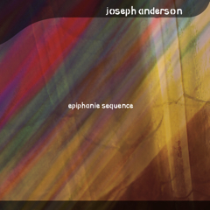
Epiphanie Sequence
Kyai Pranaja (1998)
Mpingo (2003)
Pacific Slope (2002)
Composed in full 3D (periphonic) B-format
    Using B-format source recordings
Published by Sargasso Records
UHJ Stereo on CD
B-format versions available (on request!)

Slide 3
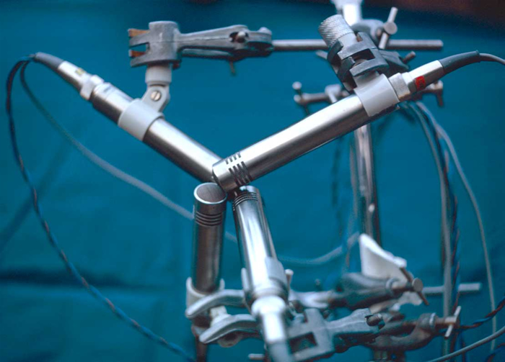
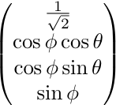
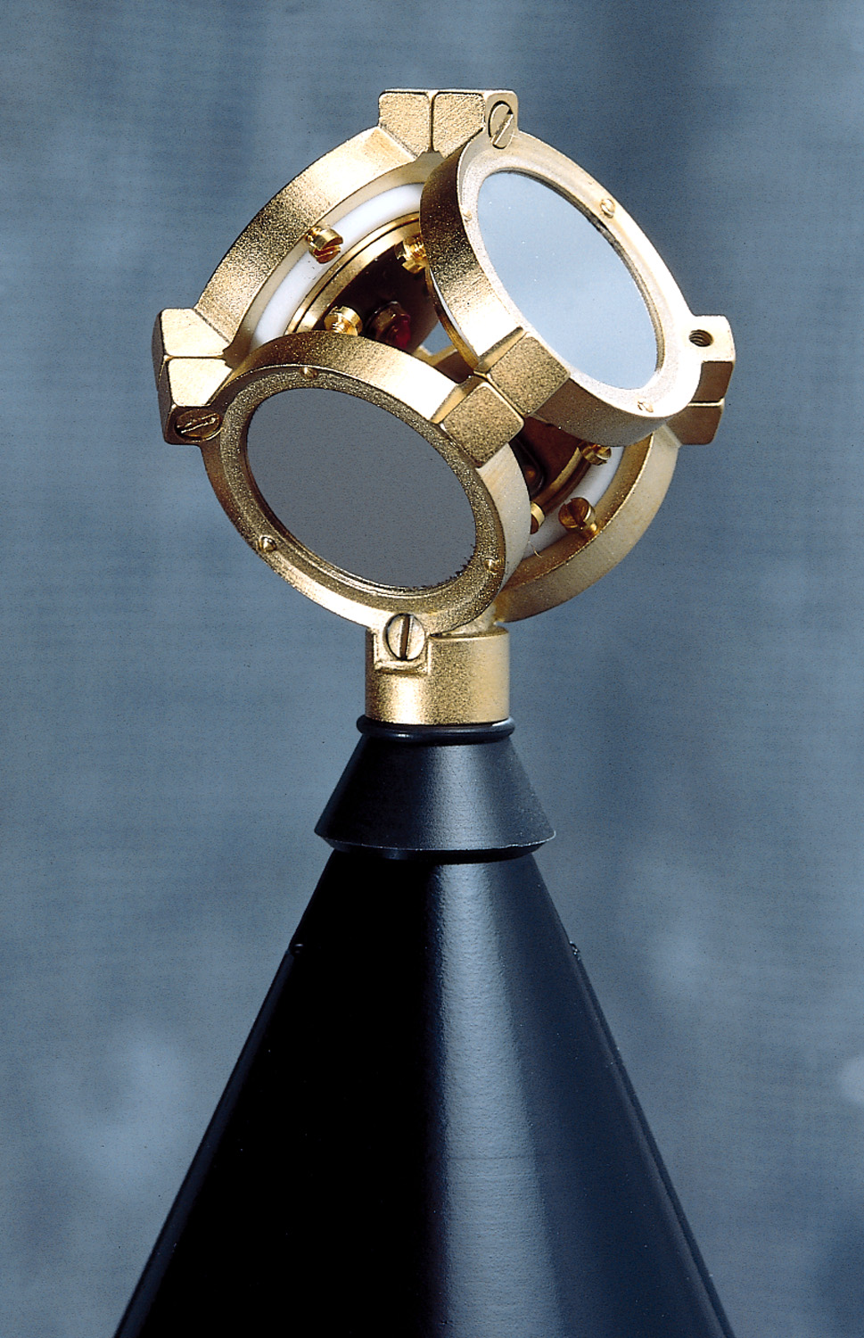
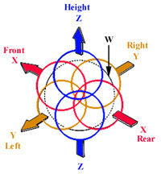
Ambisonic Encoding
OUTRS tetrahedral microphone array, courtesy Stephen Thornton
(www.michaelgerzonphotos.org.uk)
Soundfield microphone, courtesy Soundfield Ltd.
(soundfield.com)

Slide 4
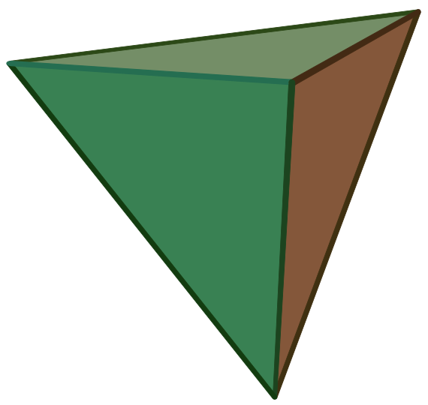

The Trick: A-format

Slide 5
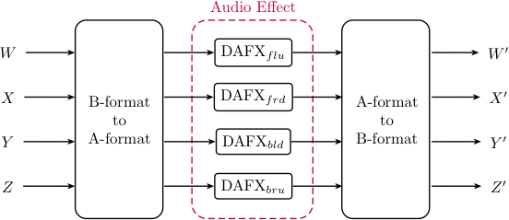
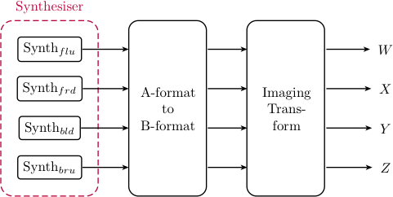
The Trick: Ambisonic Toolkit (ATK) Networks
Audio Effects
    Process in A-format!
Synthesis
    … in A-format!

Slide 6
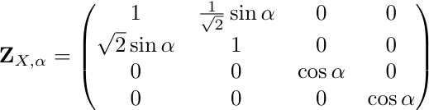
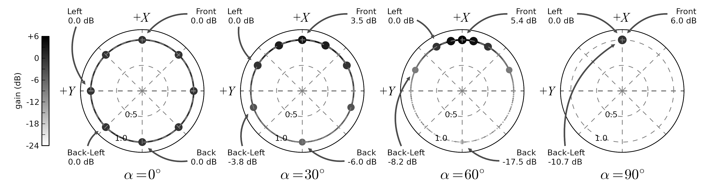
ATK Imaging: Zoom
Zoom Transform
    Dominance
    Reshape Soundfield

Slide 7
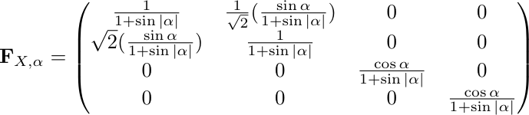
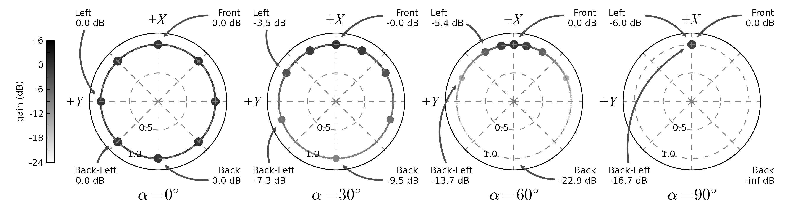
ATK Imaging: Focus
Focus Transform
    Dominance
    Related
    Reshape Soundfield

Slide 8
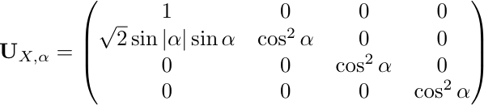
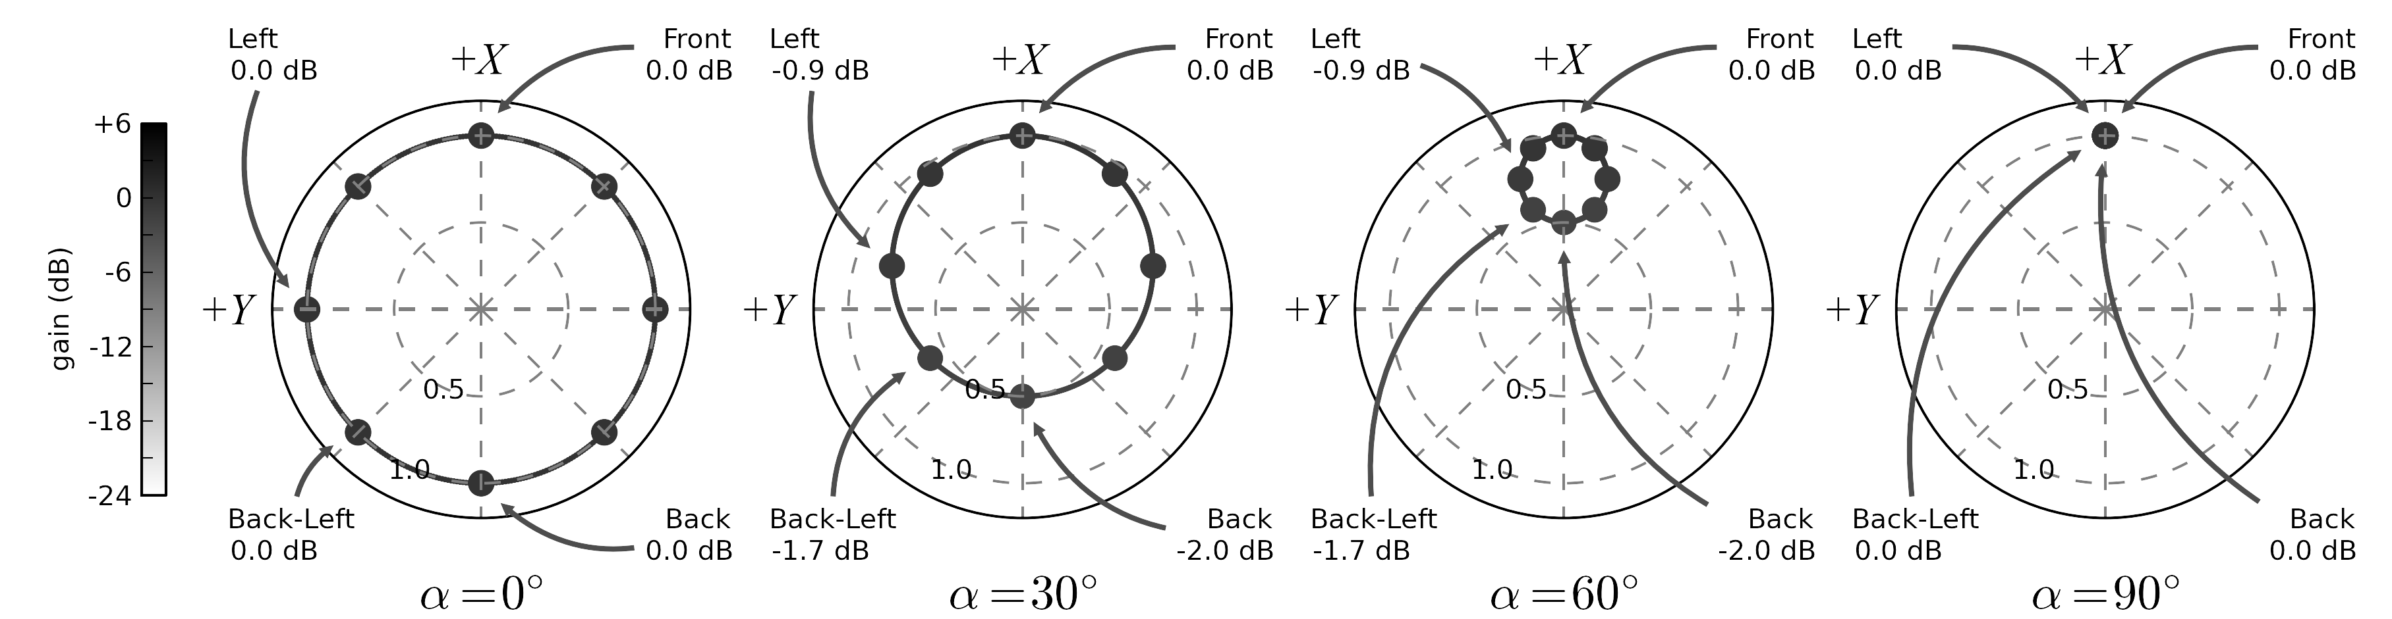
ATK Imaging: Push
Push Transform
    Two metaphors:
      Spatial Shelving-Filter
      Re-align Tetrahedron
    Reshape Soundfield

Slide 9
Listening & Discussion
Ambisonic Toolkit (SuperCollider Library)
Demonstration

Slide 10
References
[1] J. Anderson, Epiphanie Sequence, vol. 28056. London: Sargasso, 2008.
[2] J. Anderson, “Introducing... The Ambisonic Toolkit,” in Proceedings of the Ambisonics Symposium 2009, Graz, 2009.
[3] J. Anderson and J. Parmenter, “The Ambisonic Toolkit,” Ambisonic Toolkit (ATK), 2011. [Online]. Available: http://www.ambisonictoolkit.net/.
[4] J. L. Anderson, “Portfolio of Compositions,” PhD Thesis, University of Birmingham, 2003.
[5] C. Dodge and T. A. Jerse, Computer Music: Synthesis, Composition, and Performance. New York: Schirmer Books, 1985.
[6] K. Farrar, “Soundfield microphone: design and development of microphone and control unit,” Wireless World, pp. 48-50 (Oct.), 99-103 (Nov.), 1979.
[7] R. Furse, “Sound System: Methods and systems for using transforms to modify the spatial characteristics of audio data,” U.S. Patent GB 2467534 A11-Aug-2010.
[8] M. A. Gerzon, “Periphony: With-Height Sound Reproduction,” Journal of the Audio Engineering Society, vol. 21, no. 1, pp. 2-10, Feb. 1973.
[9] M. A. Gerzon, Artificial Reverberation and Spreader Devices. NRDC, 1975.
[10] M. A. Gerzon, Panpot and Soundfield Controlls. NRDC, 1975.
[11] M. A. Gerzon, “Ambisonics in Multichannel Broadcasting and Video,” Journal of the Audio Engineering Society, vol. 33, no. 11, pp. 859-871, Nov. 1985.
[12] D. G. Malham and A. Myatt, “3-D Sound Spatialization using Ambisonic Techniques,” Computer Music Journal, vol. 19, no. 4, pp. 58-70, 1995.
[13] D. Menzies, “W-panning and O-format, tools for object spatialization,” in Proceedings of the Audio Engineering Society 22nd International Conference on Virtual, Synthetic and Entertainment Audio, Espoo, Finland, 2002.
[14] SoundField Ltd., “SoundField Technology and B-Format,” SoundField: SoundField Technology and B Format, 2001. [Online]. Available: http://soundfield.com/soundfield/technology.php. [Accessed: 09-Jun-2011].
[15] S. Thornton, “Tetrahedral Recording Session Images,” Michael Gerzon Audio Pioneer, 2009. [Online]. Available: http://www.michaelgerzonphotos.org.uk/tetrahedral-recording-images.html. [Accessed: 17-Apr-2011].
[16] “Tetrahedron,” Tetrahedron - Wikipedia, the free encyclopedia, 11-May-2011. [Online]. Available: http://en.wikipedia.org/wiki/Tetrahedron. [Accessed: 09-Jun-2011].
[17] “SuperCollider: real-time audio synthesis and algorithmic composition,” SuperCollider » About. [Online]. Available: http://supercollider.sourceforge.net/. [Accessed: 15-Dec-2010].

Slide 11
Thanks!!
josephlloydanderson@mac.com
www.ambisonictoolkit.net

